Slide 1

JPA Project – Group 91 Data Bases 2 Students Codice Persona Vincenzo Riccio 10804402 Emanuele Triuzzi 10794440
Professor Piero Fraternali A.Y. 2020-2021
20th June, 2021

Slide 2
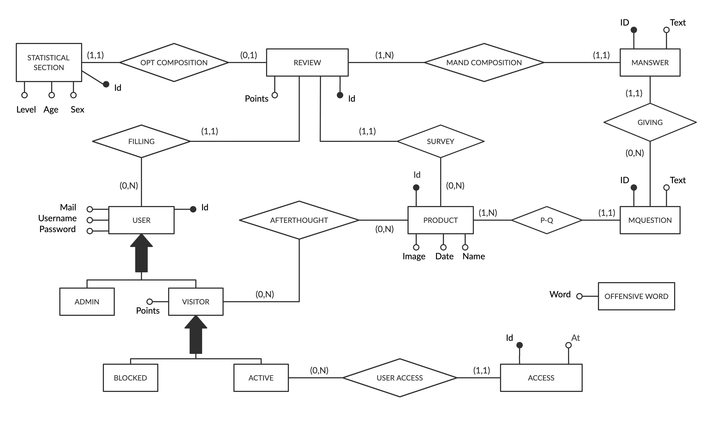
Entity Relationship

Slide 3
Relational Model
access(id, user, at) offensive_words(word)
user(id, username, password, email, isAdmin, isBlocked, points)
deleted_reviews(id, user_id, product_id)
review(id, user, age, sex, level, points, product)
product(id, name, date, image)
mquestion(id, text, product)
manswer(id, review, question, text)

Slide 4
Relationship: “Filling”
Filling
(0,N)
(1,1)
Filling
Each user can fill more reviews (for different products) and each review is filled by a user.
User → Review
@OneToMany is necessary in order to access the list of reviews filled by the user
Review is the owner
Review → User
@ManyToOne is not requested, but mapped for simplicity
User
Review
*
User
Review
1
User
Review
Notes:
User → Review @OneToMany is necessary to get the Reviews of the logged in user
Review →User @ManyToOne is not requested by the specifications (reviewer always known after login)
Unidirectional 1:N → Two solutions:
Mapping the relationship as if it were bidirectional and use only the needed side
Do not map the @ToMany side of the relationship as a collection data member and use (named) JPQL queries to retrieve the correlated objects when needed

Slide 5
Relationship: “P-Q”
P-Q
(0,N)
(1,1)
Product-Question
Each product has a variable number of mandatory questions, and each question is about a product
Product → Question
@OneToMany allows to get the list of questions about a specific product
Question is the owner
Question → Product
@ManyToOne is not requested, but implemented for simplicity
Product
Question
*
Product
Question
1
Product
Question
Notes:
User → Review @OneToMany is necessary to get the Reviews of the logged in user
Review →User @ManyToOne is not requested by the specifications (reviewer always known after login)
Unidirectional 1:N → Two solutions:
Mapping the relationship as if it were bidirectional and use only the needed side
Do not map the @ToMany side of the relationship as a collection data member and use (named) JPQL queries to retrieve the correlated objects when needed

Slide 6
Relationship: “Giving”
Giving
(0,N)
(1,1)
Giving
Each mandatory question have a number of answers based on the number of reviews (and so answers to the questions).
Question → Answer
@OneToMany allows to get the list of answers about a specific question
MAnswer is the owner
MAnswer → Question
@ManyToOne is not requested, but implemented for simplicity
MQuestion
MAnswer
*
MQuestion
MAnswer
1
MQuestion
MAnswer
Notes:
User → Review @OneToMany is necessary to get the Reviews of the logged in user
Review →User @ManyToOne is not requested by the specifications (reviewer always known after login)
Unidirectional 1:N → Two solutions:
Mapping the relationship as if it were bidirectional and use only the needed side
Do not map the @ToMany side of the relationship as a collection data member and use (named) JPQL queries to retrieve the correlated objects when needed

Slide 7
Relationship: “Mand composition”
Mand composition
(0,N)
(1,1)
Mandatory composition
Each review is composed by answers to mandatory questions
Review → MAnswer
@OneToMany allows to get the list of answers to the questions about the product the review is about
MAnswer is the owner
MAnswer → Review
@ManyToOne is not requested, but implemented for simplicity
Review
MAnswer
*
Review
MAnswer
1
Review
MAnswer
Notes:
User → Review @OneToMany is necessary to get the Reviews of the logged in user
Review →User @ManyToOne is not requested by the specifications (reviewer always known after login)
Unidirectional 1:N → Two solutions:
Mapping the relationship as if it were bidirectional and use only the needed side
Do not map the @ToMany side of the relationship as a collection data member and use (named) JPQL queries to retrieve the correlated objects when needed

Slide 8
Relationship: “Survey”
Survey
(0,N)
(1,1)
Survey
Each product has a various number of reviews
Product → Review
@OneToMany allows to get the list of answers about a specific product
Review is the owner
Review → Product
@ManyToOne is not requested, but implemented for simplicity
Product
Review
*
Product
Review
1
Product
Review
Notes:
User → Review @OneToMany is necessary to get the Reviews of the logged in user
Review →User @ManyToOne is not requested by the specifications (reviewer always known after login)
Unidirectional 1:N → Two solutions:
Mapping the relationship as if it were bidirectional and use only the needed side
Do not map the @ToMany side of the relationship as a collection data member and use (named) JPQL queries to retrieve the correlated objects when needed

Slide 9
Relationship: “User access”
User access
(0,N)
(1,1)
User access
Each user can access the application more times, each access is referred to one and only one user.
User → Access
@OneToMany allows to manage users’ accesses
Access is the owner
Access → User
@ManyToOne is not requested, but implemented for simplicity
User
Access
*
User
Access
1
User
Access
Notes:
User → Review @OneToMany is necessary to get the Reviews of the logged in user
Review →User @ManyToOne is not requested by the specifications (reviewer always known after login)
Unidirectional 1:N → Two solutions:
Mapping the relationship as if it were bidirectional and use only the needed side
Do not map the @ToMany side of the relationship as a collection data member and use (named) JPQL queries to retrieve the correlated objects when needed

Slide 10
Relationship: “Afterthought”
Afterthought
(0,N)
(0,N)
Aftertought
Each user cancel a review for a product so each review can have different repented users.
User → Product
@ManyToMany is necessary when a review of a product gets deleted
Product → User
@ManyToMany is not requested, but implemented for simplicity
User
Product
*
User
Product
*
User
Review
Notes:
User → Review @OneToMany is necessary to get the Reviews of the logged in user
Review →User @ManyToOne is not requested by the specifications (reviewer always known after login)
Unidirectional 1:N → Two solutions:
Mapping the relationship as if it were bidirectional and use only the needed side
Do not map the @ToMany side of the relationship as a collection data member and use (named) JPQL queries to retrieve the correlated objects when needed

Slide 11
Components – Client side: login and permissions
FILTERS
CheckAdminPrivileges: checks if the logged user (if any) is an admin. It applies to all the admin pages
CheckUserPrivileges: checks if the logged user (if any) is a visitor (i.e., not an admin). It applies to all the user pages
Notes:
A filter is an object that performs filtering tasks on either the request to a resource (a servlet or static content), or on the response from a resource, or both.

Slide 12
Components – Client side: login and permissions
SERVLETS
RegisterUser: register a new user if not already in the database.
CheckLogin: validates the content of the login form. It checks the credentials; if the user is an admin redirects to his home page, otherwise, it checks if the account has been blocked and, if not, redirects to the user home page
Logout: logs out the current user and invalidates the session

Slide 13
Components – Client side: user
GoToUserHomePage: shows the home page of a visitor. It finds the product of the current day and the possible review made by the logged user
GoToLeaderboardPage: shows the leaderboard page
GoToNewReviewPage: shows the first page of the review creation process for the product of the current day. It also creates the stateful bean for the review creation process
GoToNewReview2ndPage: shows the second page of the review creation process for the product of the current day
SaveReview: completes the review creation process by saving the review. It also blocks the logged user if he used offensive words in the review (and in that case the review is not saved)
DeleteReview: deletes the review made by the logged user for the product of the current day

Slide 14
Components – Client side: administrator
GoToAdminHomePage: shows the home page of an administrator
GoToCreationPage: shows the creation page for a product. It also creates the stateful bean for the product creation process
GoToInspectionPage: shows the inspection page for a past product
GoToDeletionPage: shows the deletion page for erasing the questionnaire data of a past product
CreateProduct: completes the product creation process by saving the product. It also blocks the logged user if he used offensive words in the review (and in that case the review is not saved)
EraseQuestionnaire: erases the questionnaire data of a past product
AddQuestionCreationPage: adds a new question to the product which is being added
RemoveQuestionCreationPage: removes one of the question previously inserted to the product which is being added

Slide 15
Views
USER
home.html: the home page of a visitor. If available, it includes the product of the day and reviews by other users
leaderboard.html: the leaderboard page. It shows the name and the points of who filled the questionnaire of the day
review.html: the page containing the forms for making a review
savedReview.html: the greeting page shown after a review is submitted
blockedUser.html: the page shown when a user is blocked after using an offensive word

Slide 16
Views
ADMIN
adminHome.html: the home page of an administrator. It contains the product of the day and the links for the creation, the inspection and the deletion pages.
creationPage.html: the creation page for a product. It includes the form for creating the product
inspectionPage.html: the inspection page for a past product. It allows to inspect the reviews of a past date
deletionPage.html: the deletion page for erasing the questionnaire data of a past product

